Slide 1
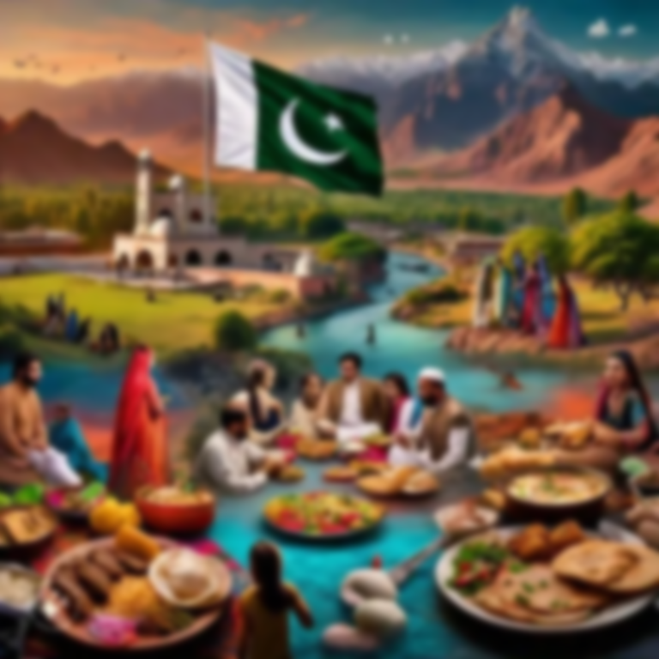

Land & People of Pakistan

Slide 2
Introduction to Pakistan
Pakistan is officially known as the Islamic Republic of Pakistan
It emerged as an independent state on 14 August 1947
Pakistan occupies a region that has historically been a center of civilization and trade
Its geography has played a vital role in shaping its political importance and defense
The country exhibits remarkable diversity in land, climate, and population
Islamabad serves as the capital city
The official currency of Pakistan is the Pakistani Rupee (PKR), denoted by the symbol "₨“
Four Provinces are Punjab, Sindh, Khyber Pakhtunkhwa, Balochistan

Slide 3
Historical Significance of the Land
The region was home to the Indus Valley Civilization, one of the world’s earliest civilizations
Successive invasions and migrations passed through this land due to mountain passes
Muslim rule shaped cultural, social, and religious identity of the region
British colonial policies influenced irrigation, administration, and infrastructure
Partition in 1947 reshaped demographics and settlement patterns

Slide 4
Geographical Location of Pakistan
Pakistan lies between 24° to 37° North latitude and 61° to 75° East longitude
It is located at the crossroads of South Asia, Central Asia, and the Middle East
The country covers an area of approximately 796,096 square kilometers
Its location exposes it to diverse climatic influences and tectonic activity
This location enhances both opportunities and challenges for Pakistan

Slide 5
Global Power Competition & Pakistan’s Strategic Location
World Island: The term used to describe the combined landmass.
Heartland Theory: Refers to the central region of Eurasia which holds the key to global power due to its vast land resources, strategic depth, and inaccessibility to sea power.
Rimland Theory: The coastal fringe surrounding the Heartland where control over maritime routes and population centers determines global dominance.
Geo-strategy: Refers to the formulation of foreign and security policies based on geographic realities, focusing on military positioning, alliances, and control of strategic regions.
Geopolitics: The study of how geography, including location, climate, resources, and population, influences a state’s political power, foreign policy, and international relations.
Geo-economics: Involves the use of economic tools such as trade, investment, sanctions, and aid to achieve geopolitical objectives and enhance national influence.

Slide 6
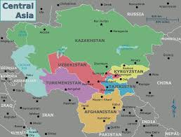
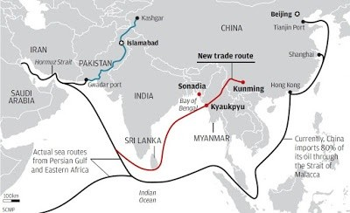
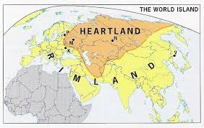

Slide 7
Borders and Neighboring Countries
Pakistan shares its eastern border with India, marked by political tension
Afghanistan lies to the northwest with a historically porous border
Iran borders Pakistan in the southwest
China is located in the northeast, connected via the Karakoram Highway
The Arabian Sea forms Pakistan’s southern boundary, providing access to global trade

Slide 8
Strategic Importance of Pakistan’s Location
Pakistan’s location gives it strategic military and economic importance
It serves as a gateway to landlocked Central Asian states
Proximity to Middle Eastern oil reserves increases geopolitical relevance
Ports like Gwadar enhance maritime trade potential
The region remains significant in global and regional politics

Slide 9
Physical Divisions of Pakistan
Pakistan’s land is divided into distinct physical regions
Each region has unique relief, climate, and economic activities
The major physical divisions are:
Northern and Northwestern Mountains
Western Highlands
Indus Plain
Desert Regions
Coastal Areas
These divisions strongly influence population distribution

Slide 10
Northern and Northwestern Mountains
This region includes the Himalayas, Karakoram, and Hindu Kush ranges
These are young fold mountains formed by tectonic collision
The area contains some of the highest peaks and longest glaciers
It acts as a climatic barrier against cold winds
The region is sparsely populated but rich in natural beauty and water resources

Slide 11
Major Mountain Peaks
K2 is the second highest mountain in the world
Nanga Parbat is known for its steep slopes and high fatality rate
Tirich Mir dominates the Hindu Kush range
Mountain peaks contribute to tourism and national pride
These mountains are also a source of perennial rivers

Slide 12
Important Mountain Passes
Khyber Pass has historically connected South Asia with Central Asia
Bolan Pass links Balochistan with the Indus Plain
Khojak Pass facilitates trade between Pakistan and Afghanistan
Passes played a crucial role in invasions, trade, and cultural exchange
Even today, these passes hold strategic importance

Slide 13
Western Highlands
The Western Highlands cover most of Balochistan Plateau
The region is characterized by dry climate and rugged terrain
Mountain ranges include Sulaiman and Kirthar ranges
Scarcity of water limits agriculture and settlement
Despite hardships, the region is rich in mineral resources

Slide 14
Indus Plain
The Indus Plain is formed by alluvial deposits over thousands of years
It is one of the most fertile plains in the world
The plain supports intensive agriculture
Major cities and population centers are located here
It plays a central role in Pakistan’s food security

Slide 15
Upper Indus Plain
Lower Indus Plain
Located mainly in Punjab province
Extensive canal irrigation system developed during British period
Produces major cash and food crops
Dense population due to fertile land and employment opportunities
Industrial development is also concentrated in this region
Situated in Sindh province
Climate is hotter and drier than Upper Indus Plain
Agriculture heavily depends on irrigation canals
Rice and cotton are major crops
Flooding is a recurring problem in this region

Slide 16
Desert Regions of Pakistan
Pakistan has several deserts with harsh climatic conditions
Thar Desert lies in Sindh and eastern Punjab
Cholistan Desert is an extension of the Thar Desert
Thal Desert lies between rivers Indus and Jhelum
Livestock rearing is the main livelihood in deserts
Western areas, like Balochistan, are arid with desert landscapes

Slide 17
River System of Pakistan
The Indus River is the backbone of Pakistan’s river system
It originates near Lake Manasarovar in Tibet
The river flows through Gilgit-Baltistan, KP, Punjab, and Sindh
It drains into the Arabian Sea
The river system sustains agriculture and settlements

Slide 18
Tributaries of the Indus
Major tributaries include Jhelum, Chenab, Ravi, and Sutlej
These rivers mainly flow through Punjab
They form one of the world’s largest irrigation systems
River waters are regulated through dams and barrages
The Indus Waters Treaty governs river water distribution

Slide 19
Importance of Rivers
Rivers provide water for irrigation and drinking
Support hydroelectric power generation
Enable fertile agricultural plains
Help maintain ecological balance
Historically influenced settlement patterns

Slide 20
Climate of Pakistan
Pakistan generally experiences a continental climate
Summers are extremely hot in plains
Winters are severe in northern mountainous regions
Climate varies with altitude and latitude
Seasonal extremes affect agriculture and daily life

Slide 21
Seasons in Pakistan
Summer season lasts from April to September
Winter season extends from October to March
Monsoon rains occur during July and August
Northern areas receive snowfall in winter
Seasonal variation impacts crop cycles

Slide 22
Rainfall Distribution
Rainfall in Pakistan is uneven and irregular
Northern mountains receive the highest rainfall
Punjab receives moderate rainfall
Balochistan and deserts receive minimal rainfall
Dependence on monsoon increases vulnerability to floods

Slide 23
Natural Resources of Pakistan
Pakistan possesses significant mineral resources
Coal is found in Sindh and Balochistan
Natural gas fields include Sui and Mari
Rock salt is extracted from Salt Range
Proper utilization of resources remains a challenge

Slide 24
Agricultural Resources
Agriculture is the backbone of Pakistan’s economy
Fertile soil and irrigation support crop production
Major crops include wheat, rice, cotton, and sugarcane
Agriculture provides employment to a large population
Agricultural productivity varies by region

Slide 25
Environmental Problems
Deforestation due to population pressure
Water scarcity and mismanagement
Floods and droughts causing economic losses
Urban pollution affecting health
Climate change increasing environmental risks

Slide 26
Population of Pakistan
Pakistan has one of the fastest-growing populations
Population distribution is uneven
Plains are densely populated
Mountainous and desert areas have low population density
Rapid urbanization is creating new challenges
Urbanization is on the rise, with major cities like Karachi, Lahore, and Islamabad experiencing rapid growth and development

Slide 27
Ethnic Composition of Pakistan
Pakistan is home to diverse ethnic groups
Major groups include Punjabis, Sindhis, Pashtuns, and Baloch
Each group has its own language and traditions
Ethnic diversity enriches national culture
Unity is maintained through shared religion and history

Slide 28
Punjabi Population
Punjabis form the largest ethnic group
Mostly reside in Punjab province
Agriculture is the main occupation
Punjabi language has several dialects

Slide 29
Sindhi Population
Sindhis are the original inhabitants of Sindh
They have a rich cultural and literary heritage
Majority live in rural areas
Sindhi language has ancient roots
Agriculture dominates economic life

Slide 30
Pashtun Population
Pashtuns inhabit KP and northern Balochistan
Tribal structure dominates social life
Pashto is the main language
Pashtunwali guides social behavior
Known for hospitality and bravery

Slide 31
Baloch Population
Baloch people live mainly in Balochistan
Tribal affiliations are strong
Population density is very low
Economic development is limited
Natural resources have potential for growth

Slide 32
Languages of Pakistan
Urdu is the national language
English is the official language
Regional languages reflect ethnic diversity
Language promotes cultural identity
Multilingualism is a national feature

Slide 33
Culture of Pakistan
Culture is deeply influenced by Islam
Family system is strong
Respect for elders is emphasized
Traditional dress and food vary by region
Cultural festivals reflect regional diversity

Slide 34
Religion in Pakistan
Islam is the state religion
Majority population is Muslim
Religious minorities enjoy constitutional rights
Religion influences laws and social values
Mosques play a central social role

Slide 35
Rural Life in Pakistan
Urban Life in Pakistan
Majority of rural population depends on agriculture
Joint family system is common
Limited access to education and healthcare
Strong community ties exist
Rural areas preserve traditional culture
Urban population is increasing rapidly
Cities offer better services and employment
Industrial and service sectors dominate
Urbanization creates housing and pollution problems
Lifestyle differs significantly from rural areas

Slide 36
Relationship Between Land and People
Landforms influence settlement and occupation
Climate affects housing, clothing, and food habits
Rivers support dense populations and farming
Mountains provide defense and resources
Human activities also impact the land

Slide 37
Unity in Diversity
Pakistan’s diversity is a national strength
Different cultures coexist within one state
Shared religion unites people
National symbols promote unity
Diversity contributes to cultural richness

Slide 38
Culture of Pakistan
Festivals: Eid-ul-Fitr, Eid-ul-Adha, Basant, Shandur Polo Festival, and Urs of Sufi saints
Art & Craft: Pottery (Multani blue pottery), Truck Art, Handicrafts (Ajrak, carpets, shawls)
Pakistan is a melting pot of diverse cultures, languages, and traditions, shaped by its rich history, geographical diversity, and interactions with neighboring regions
The country's cultural mosaic reflects influences from various ethnic groups, religions, and historical civilizations.
Cultural exchange, mutual respect, and solidarity are essential values that bind the nation together

Slide 39
People of Pakistan
Population: Over 240 million (5th most populous country in the world)
Urban & Rural Distribution: About 37% urban and 63% rural
Major Cities: Karachi, Lahore, Islamabad, Peshawar, Quetta
Cultural Heritage: Rich blend of ancient civilizations, Islamic heritage, and modern influences
Hospitality: Known for their hospitality and diverse cuisine, which includes biryani, kebabs, nihari, etc.
Pakistan's population comprises a multitude of ethnic groups, including Punjabis, Pashtuns, Sindhis, Baloch, Muhajirs, and others where each group contributes to the country's cultural tapestry through its language, cuisine, music, dance, and folklore

Slide 40
Heritage & Landmarks
Historic Sites: Mohenjo-Daro, Harappa, Rohtas Fort, Lahore Fort, Badshahi Mosque, and Faisal Mosque
World Heritage Sites: Pakistan has six UNESCO World Heritage sites, including Taxila and the archaeological remains at Mohenjo-Daro

Slide 41
Natural Resources & Agriculture
Resources: Natural gas, coal, salt (Khewra Salt Mine), copper, and fertile land
Agriculture: Main crops are wheat, rice, cotton, and sugarcane. The Indus River plays a key role in irrigation
Livestock: Buffaloes, cattle, and sheep farming are integral to rural life
Abundant natural resources, including minerals, fertile soils, water resources, and biodiversity (agriculture, mining, and tourism) contributes to the country's development and prosperity
Pakistan's significant population is engaged in agriculture and rural livelihoods

Slide 42
Challenges & Opportunities
Poverty
Inequality
Social Tensions
Population Growth: Rapidly increasing population leading to urbanization challenges.
Economic Growth: Pakistan is an emerging market with opportunities in IT, textiles, and agriculture.
Environmental Concerns: Deforestation, water scarcity, and pollution are major issues.
Despite challenges, Pakistan's communities demonstrate resilience, hospitality, and a spirit of unity in the face of adversity

Slide 43
Conclusion
Pakistan has diverse physical and human geography
Land and people are closely interconnected
Geography shapes economy and culture
Sustainable development requires balance
Understanding this topic is essential for national progress

